Slide 1

Face Recognition System Your Face is the Key

Slide 2

NeubAItics Mission
Our mission is to empower both businesses and individuals by delivering innovative solutions that harness the potential of AI and Generative AI. We strive to address complex challenges and transform them into opportunities, enabling growth and progress through intelligent technology. With a focus on cutting-edge advancements, we aim to create solutions that are not only impactful but also adaptive to the evolving needs of our clients. By fostering a culture of research excellence and innovation, we are committed to driving meaningful change and unlocking new possibilities for the future

Slide 3

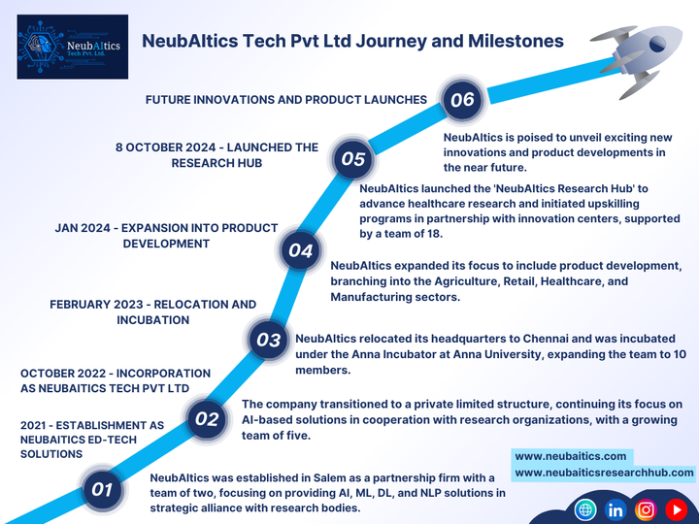
NeubAItics Journey of Innovation and Growth

Slide 4
Problem Statement
In today’s fast-paced retail, industrial, and corporate environments, traditional attendance and monitoring systems fall short of meeting efficiency demands. Poor lighting conditions and inconsistent facial postures hinder accurate recognition, leading to frequent errors. Lengthy queues for attendance logging disrupt productivity, while manual tracking systems are prone to mistakes and inefficiencies. Additionally, these systems lack robust security, leaving organizations vulnerable to unauthorized access and identity fraud.

Slide 5
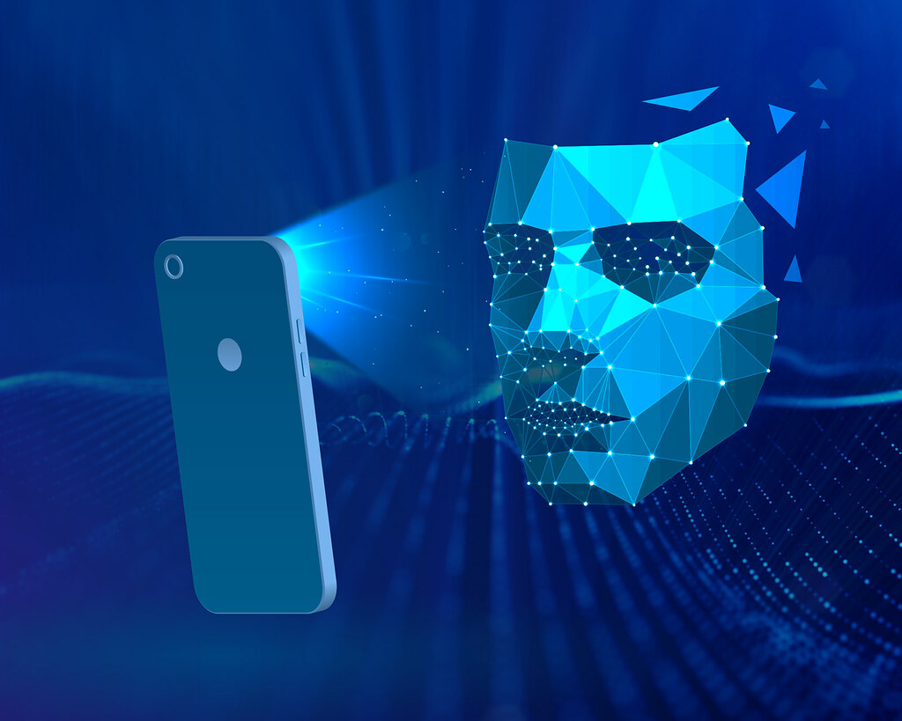


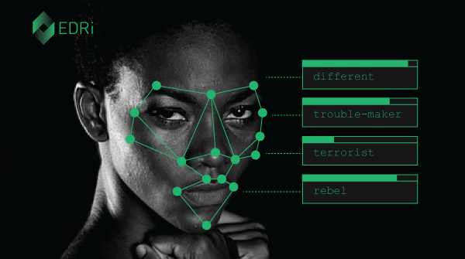

Solution
Our AI-powered face recognition system addresses these challenges with cutting-edge technology and innovative features.
Unlike traditional systems, our solution captures faces in any posture or angle, ensuring seamless identification without requiring individuals to adjust their positions
Our system enables real-time activity monitoring, providing detailed insights into attendance trends and compliance without manual intervention.
This Pho
Our system uses advanced AI algorithms to ensure accurate facial recognition, even in low-light conditions, eliminating lighting-related errors.
Attendance is recorded in fractions of a second, significantly reducing wait times and eliminating the need for queues. This boosts efficiency, especially in high-traffic areas.
Leveraging AI-driven anti-spoofing measures, our system ensures only authorized individuals are recognized, enhancing overall security.

Slide 6
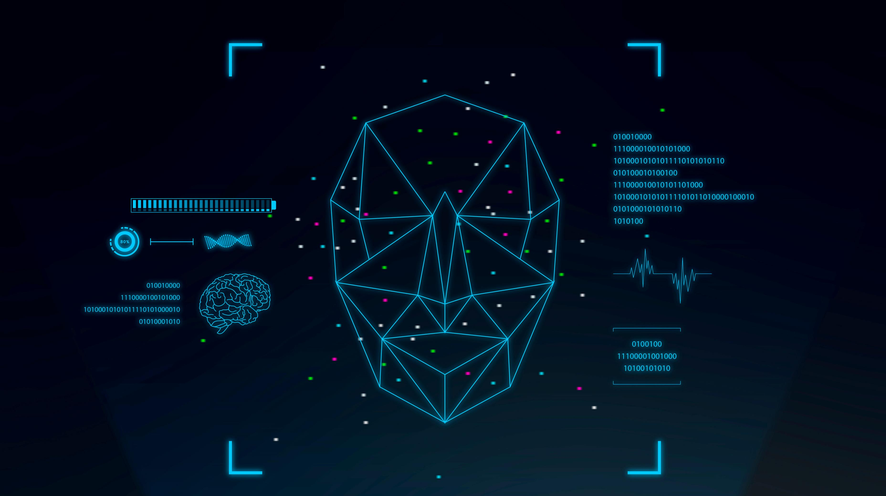









Features Added and AI Integration
Current features
Future Integration with AI
Real-time Face Detection and Recognition
Customizable Access Levels
User-Friendly Interfaces
Integration with Security Systems
Multi-Factor Authentication
Emotion Detection
Voice-Activated Recognition
Predictive Behavioral Analysis
Cloud-Based Data Processing

Slide 7





Go-To-Market Strategy
Target Audience
The face recognition system caters to offices, banks, and government agencies for advanced security and access control. It benefits schools with automated attendance and monitoring and supports healthcare, smart homes, and retail with personalized experiences and efficient identification.
Marketing
Marketing will highlight the system’s convenience and security through targeted campaigns, testimonials, and case studies. Digital strategies like SEO, influencer collaborations, and tech expo demos will boost engagement and visibility
Channels
The product will be distributed through partnerships with distributors, system integrators, and smart device manufacturers. E-commerce platforms and retail stores will provide direct access for customers
Pilot Programs
Pilot programs will be launched in schools, hospitals, retail stores, and smart homes to test the system’s efficiency in attendance, security, and automation, gathering feedback to refine its features

Slide 8
Market Size: Past and Future
Current Market | Future Market | Target Market
As of 2024, the global face recognition market is valued at $7.7 billion, driven by increased demand for advanced security systems and authentication solutions across industries like finance, healthcare, and government. | By 2030, the face recognition market is projected to grow significantly, reaching $16.5 billion, with key growth factors including advancements in AI technologies, growing adoption in smart devices, and rising security concerns. | The system targets industries such as offices, healthcare, education, and retail, alongside catering to approximately 70 million differently-abled individuals globally for accessibility and security needs.

Slide 9



Revenue Model
Our revenue model includes a one-time purchase of the face recognition system, with tiered pricing based on features like access control, authentication, and system integration. This allows businesses and individuals to choose the solution that best fits their needs, from basic face recognition to advanced, enterprise-level functionality.
Our B2B strategy focuses on licensing our face recognition technology to security integrators and device manufacturers. We also seek collaborations with governments and corporations for large-scale deployments in high-security areas. These partnerships expand our reach and position us as a trusted provider of secure, scalable surveillance solutions.
We offer a subscription model for regular AI updates, advanced features, and analytics reports. Customers can also subscribe to cloud storage for secure data and log storage. This ensures businesses stay updated with the latest features while maintaining data security.
Product Sales
Subscription Services
B2B
Partnerships

Slide 10
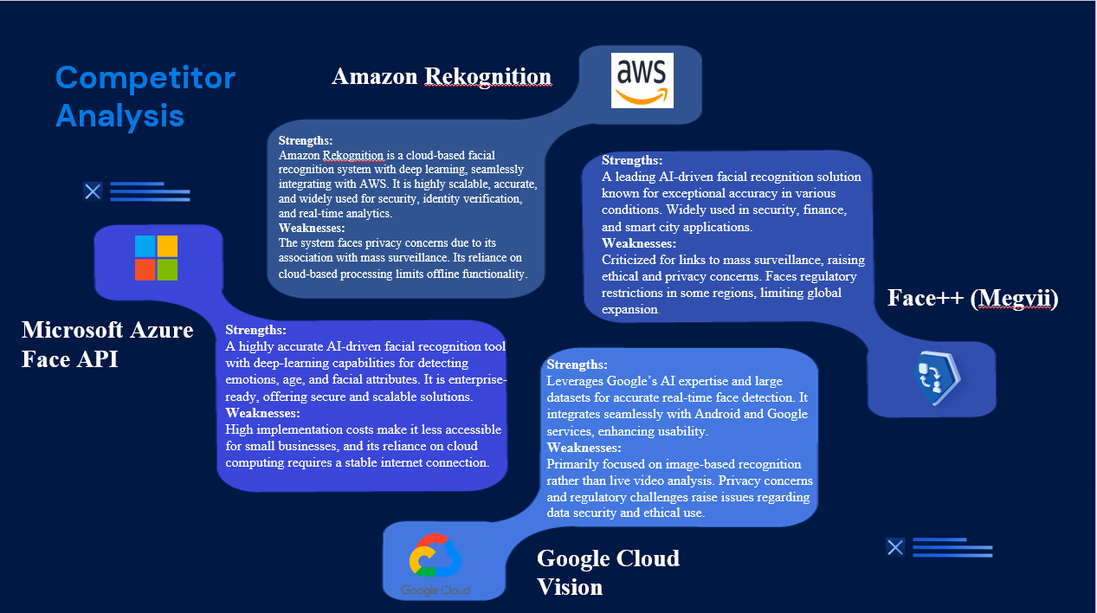


Slide 11
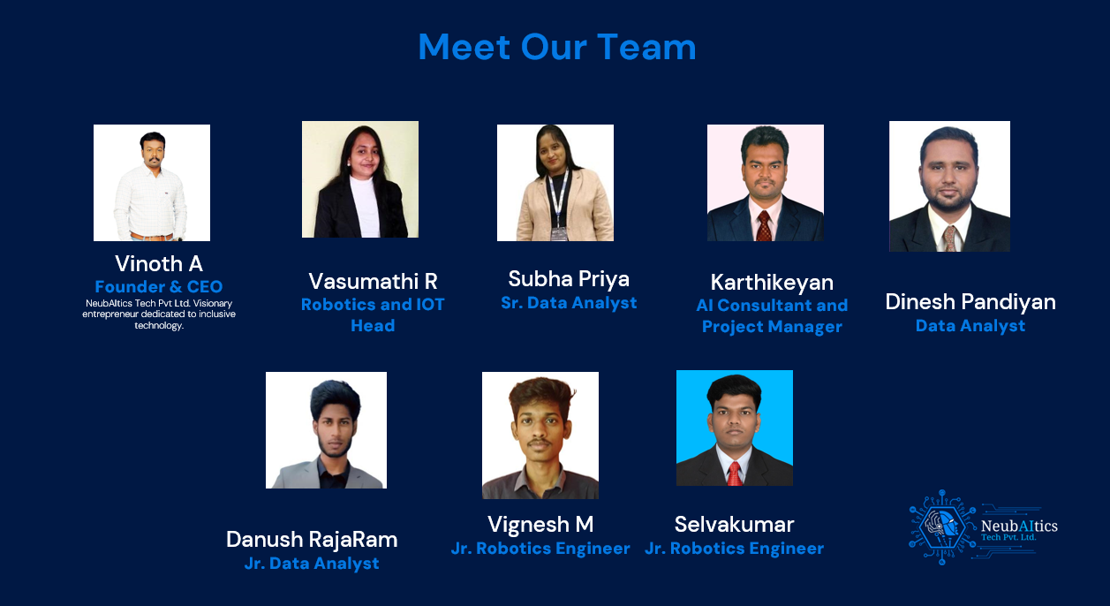

Slide 12
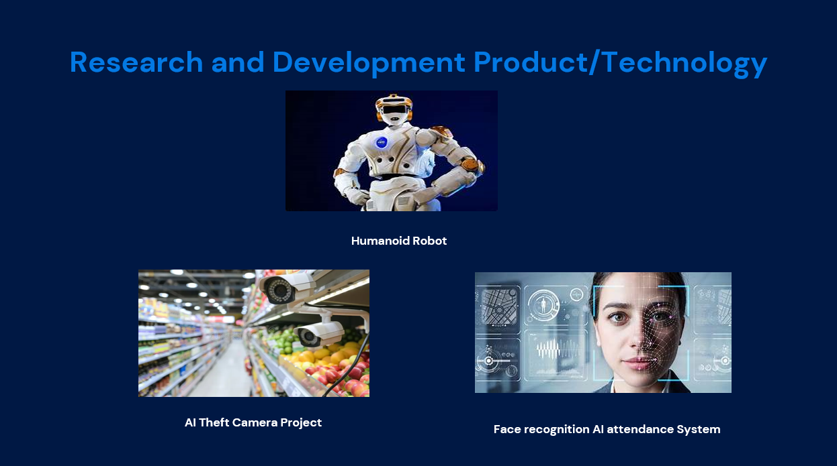

Slide 13


Slide 14
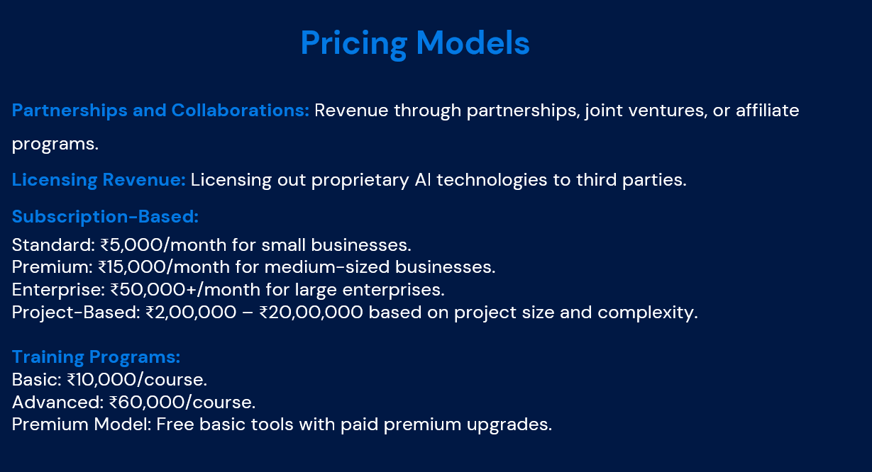

Slide 15
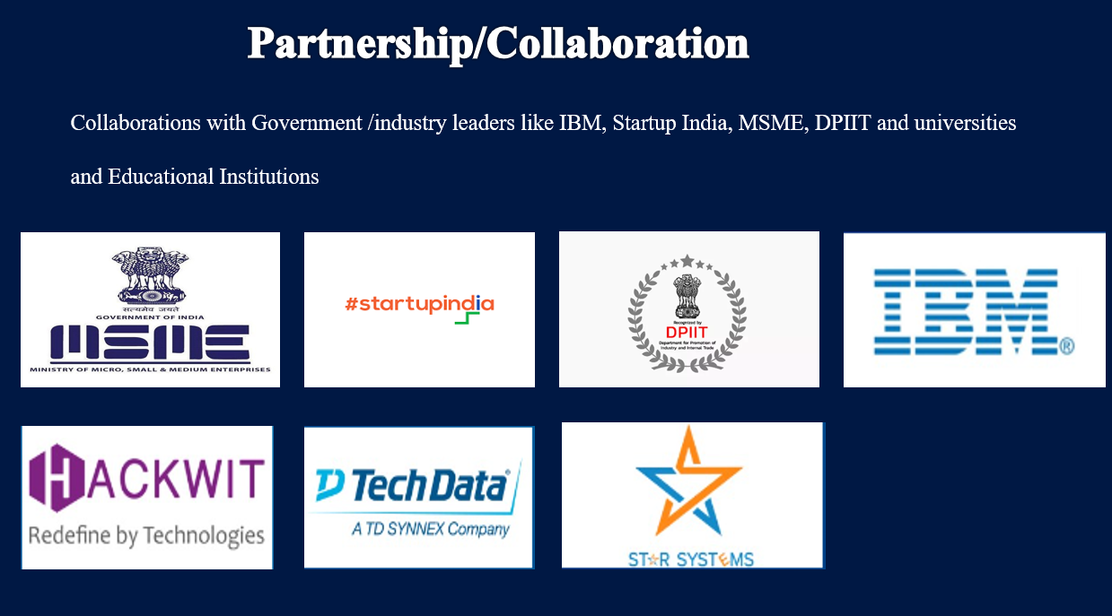

Slide 16


